Slide 1
Hassan El Abdallah / Project Manager, Backend Developer
Ghaleb Mitwalle / UI Designer, Frontend Developer
Abdulaziz Binafif / Tester, System Analyst
Khawlah Alshubati / Administrator, Database Manager
Docfinder
Web scraping tool to scrap doctors data
_{Intermediate presentation}
_{Group 5}

Slide 2
outline
Software Development Life Cycle (SDLC)
Aim of the Project
Project Actors
Feasibility Study
Requirement analysis
System design and modelling
Conclusion

Slide 3
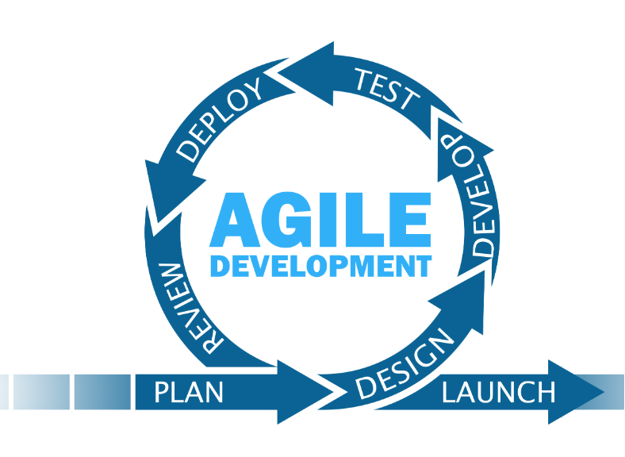
SDLC
AGILE

Slide 4
Project Aim
Developing a web scraping system that gathers comprehensive data about doctors from various sources. It aims to create a centralized platform for users to search, view, and review doctors based on specialties, qualifications, locations, and patient feedback. The goal is to provide users with a valuable resource for making informed decisions when selecting healthcare professionals.

Slide 5
Project actors
System Admin: is the person who manages the database of the system.
System crawler: is the person who scraps websites to update doctors’ data.
System User: is the website visitor who searches for doctors’ information.

Slide 6
Feasibly study
Technical feasibility: used available technology resources
Operational feasibility: impacts existing processes
Economic feasibility: financial viability

Slide 7
Requirements analysis

Slide 8
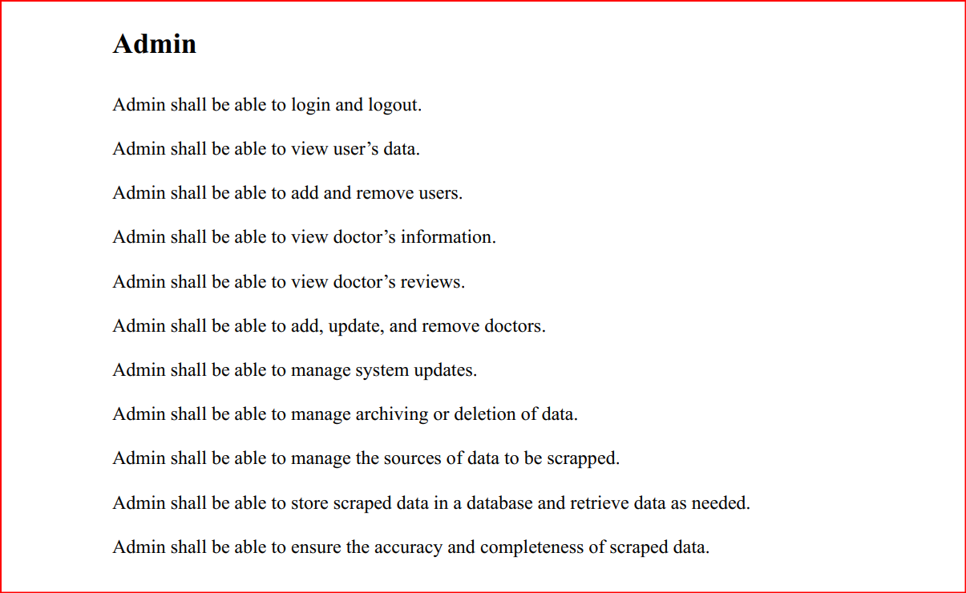
Functional requirements

Slide 9
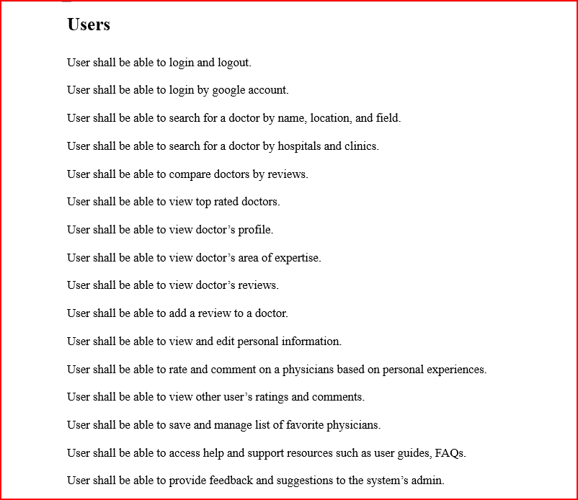
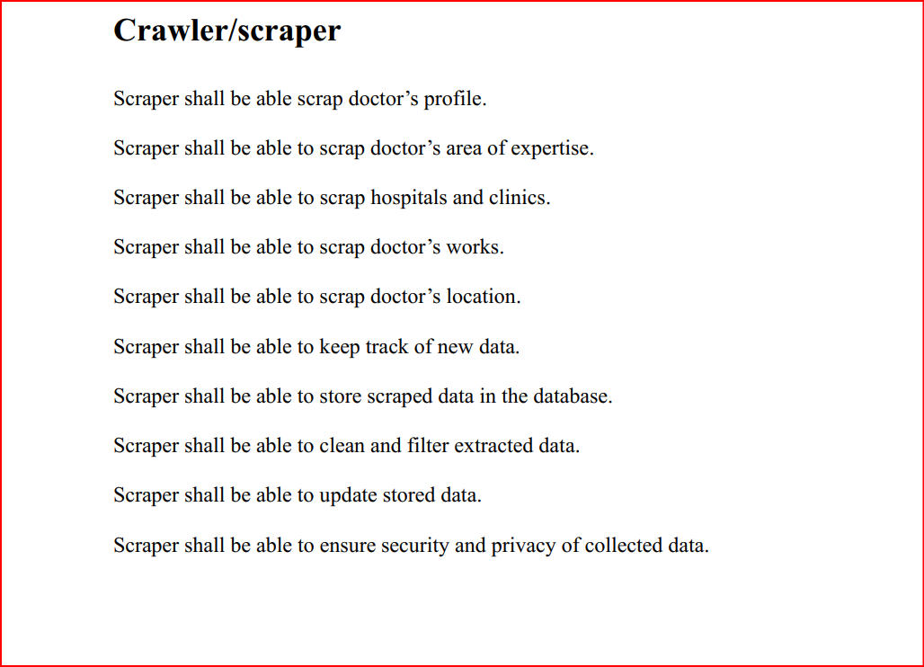
Functional requirements

Slide 10
Non-functional requirements
Performance > throughput, scalability
Safety > data privacy, use of third party libraries
Security > user authentication, data encryption, secure data storage.
Maintainability > code readability, clear documentation.
Reusability > reuse scraped components
Usability > ease of navigation, intuitive user interface, clear error messages

Slide 11
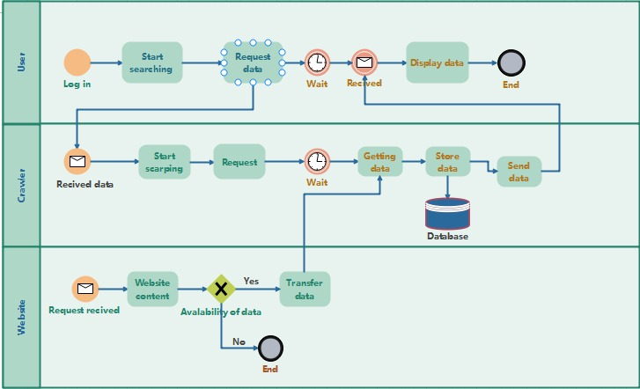
BPMN Diagram

Slide 12
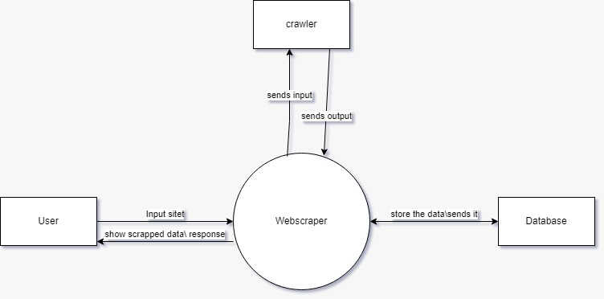
Context diagram

Slide 13
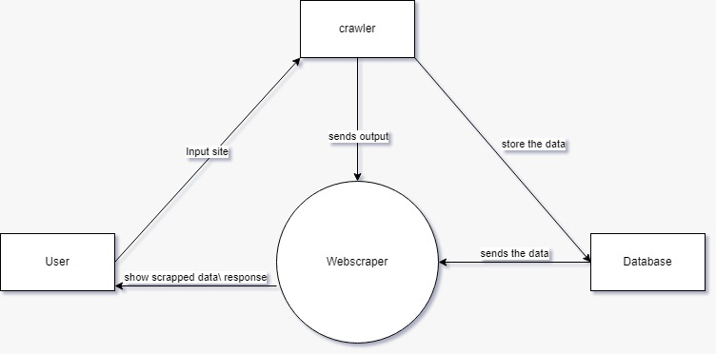
Data flow diagram

Slide 14
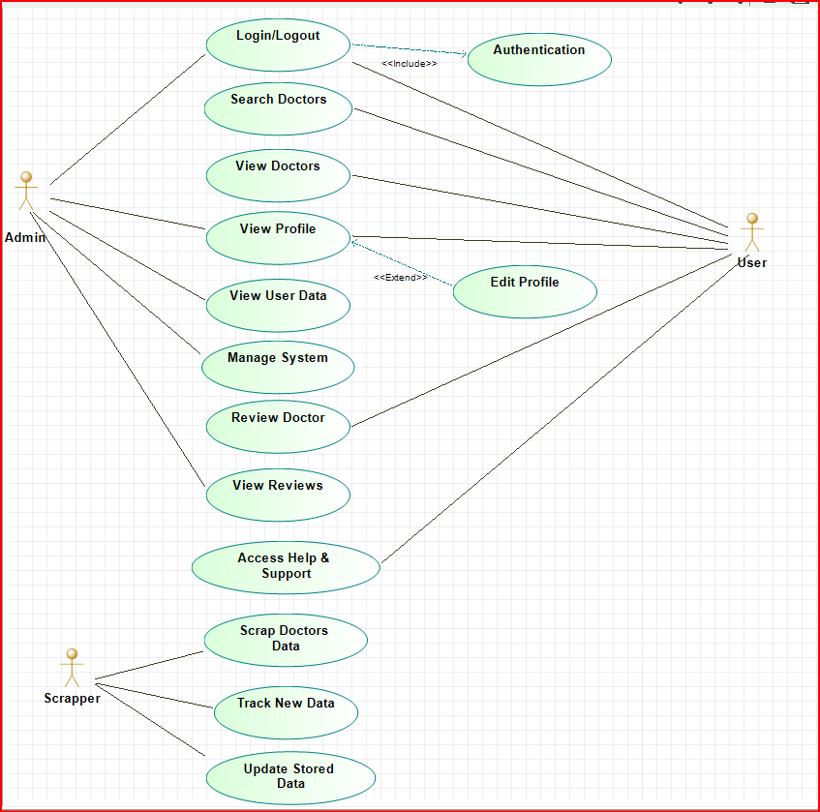
Use case diagram

Slide 15
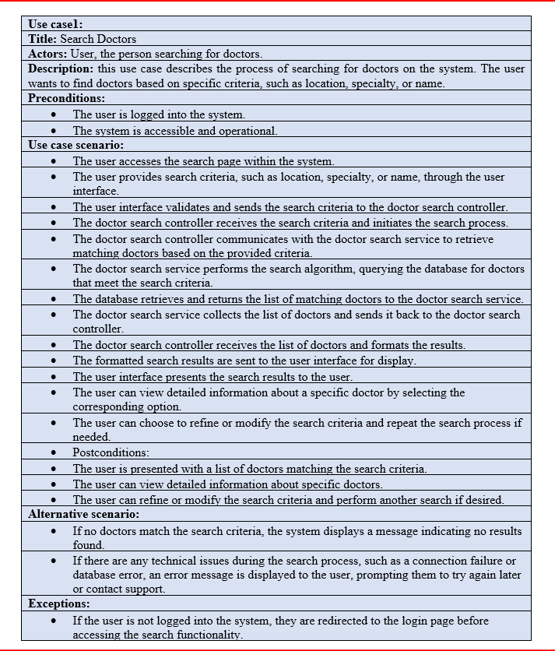
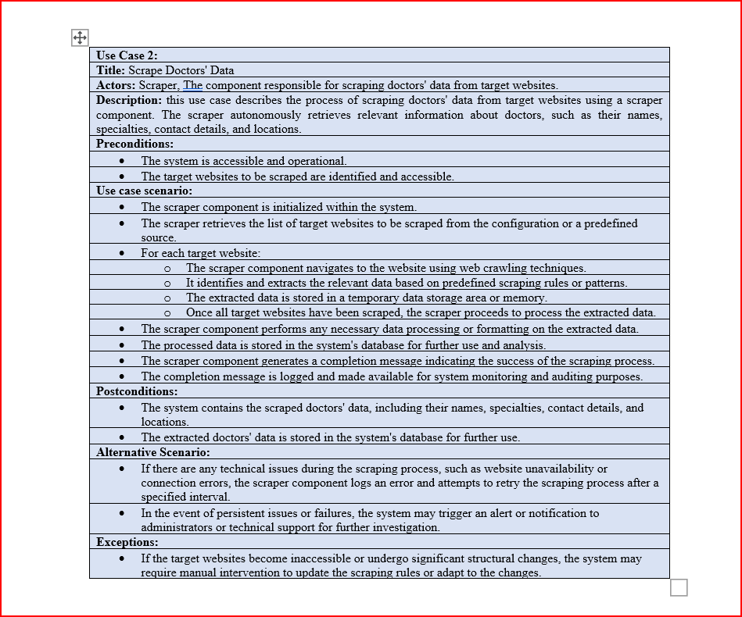
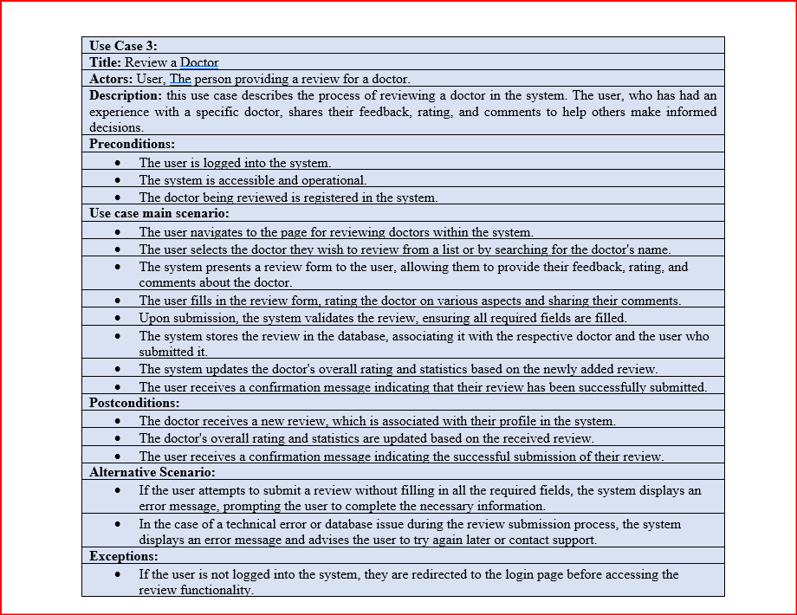
Use case narratives

Slide 16
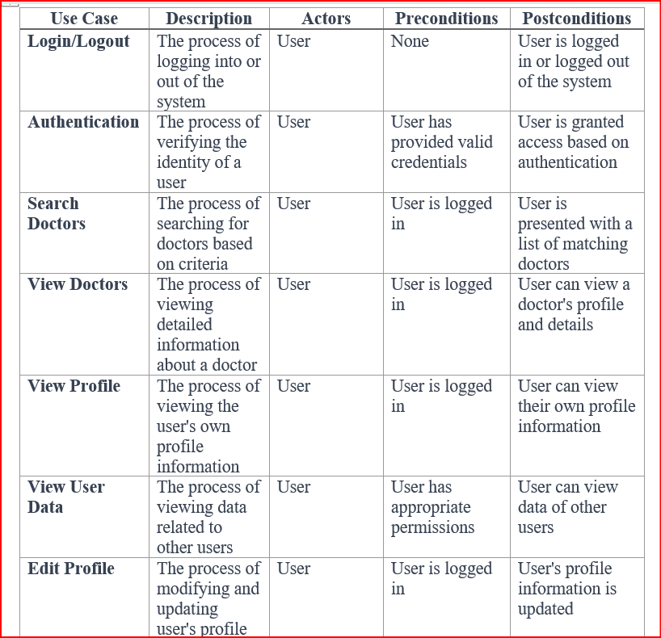
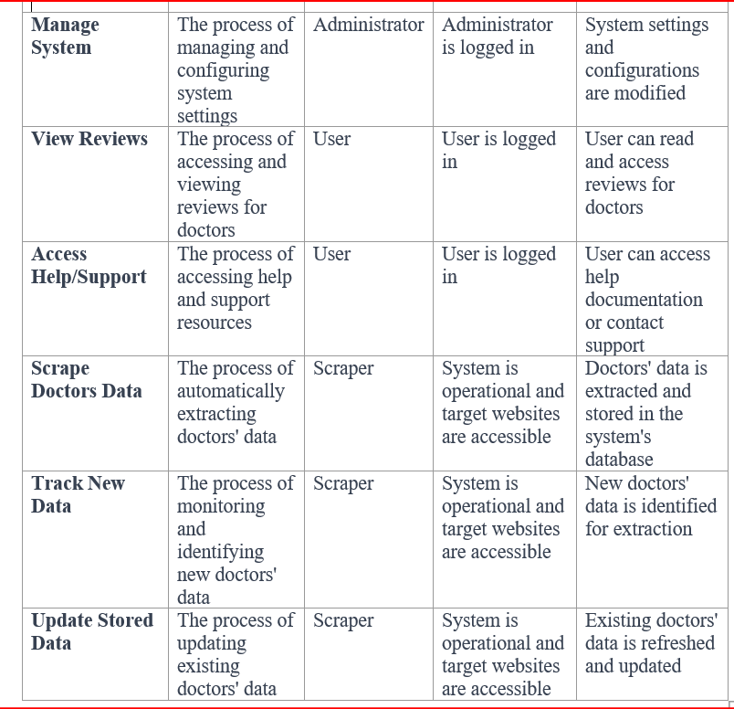
Use case glossary

Slide 17
System design & modeling

Slide 18
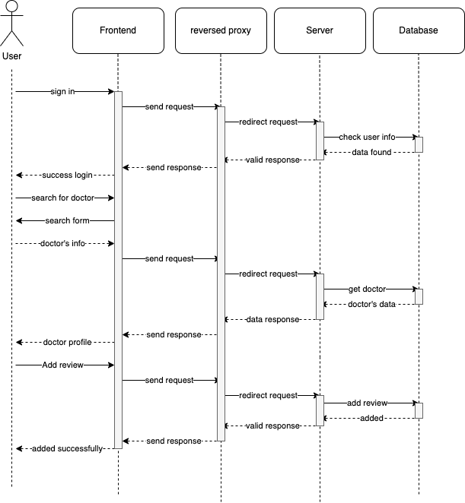
Sequence diagram

Slide 19
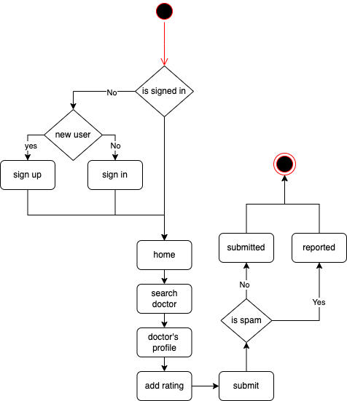
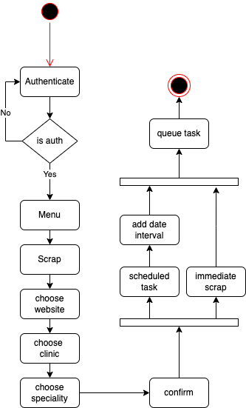
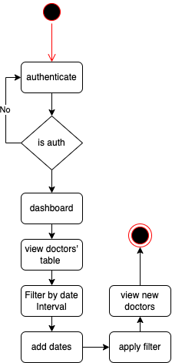
Activity diagrams

Slide 20
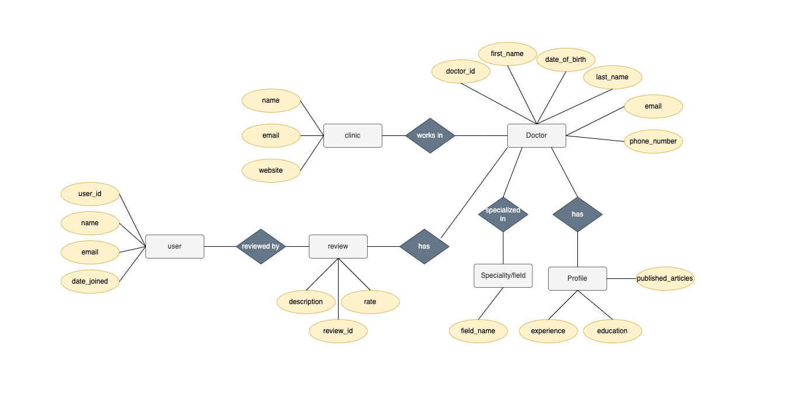
Er diagram

Slide 21
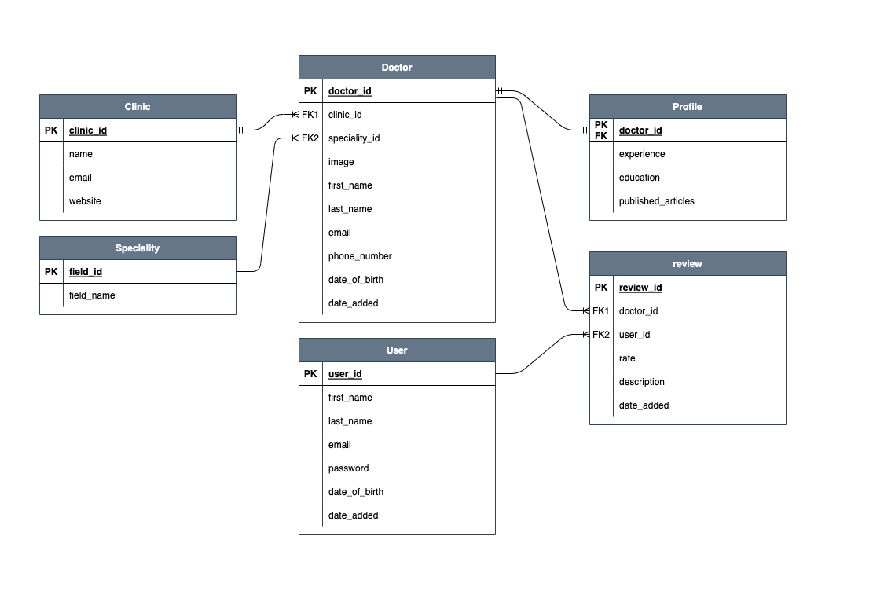
PDM diagram

Slide 22
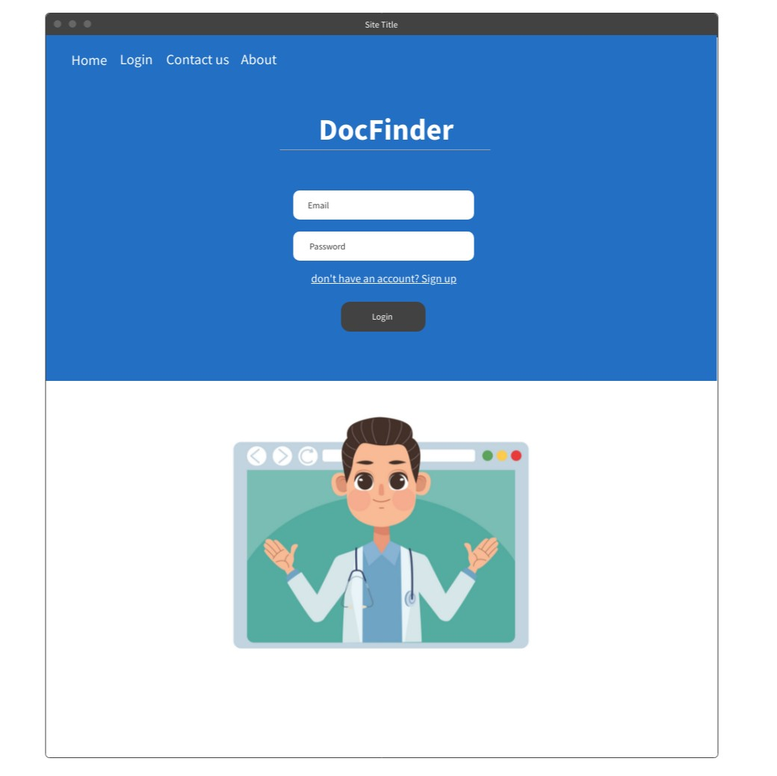
User interface
Login/ sign in page

Slide 23
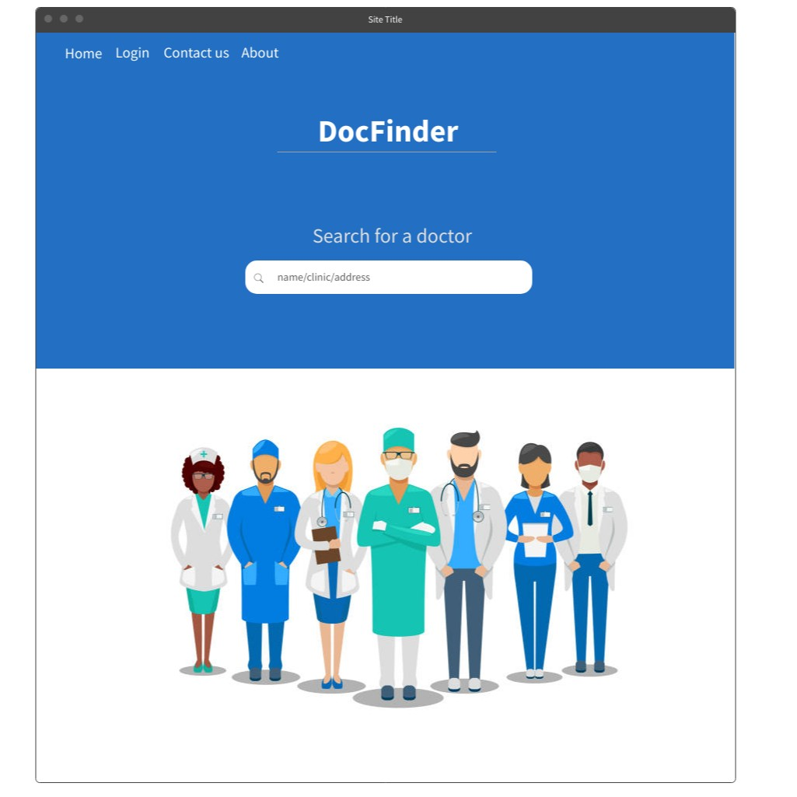
User interface
Main page

Slide 24
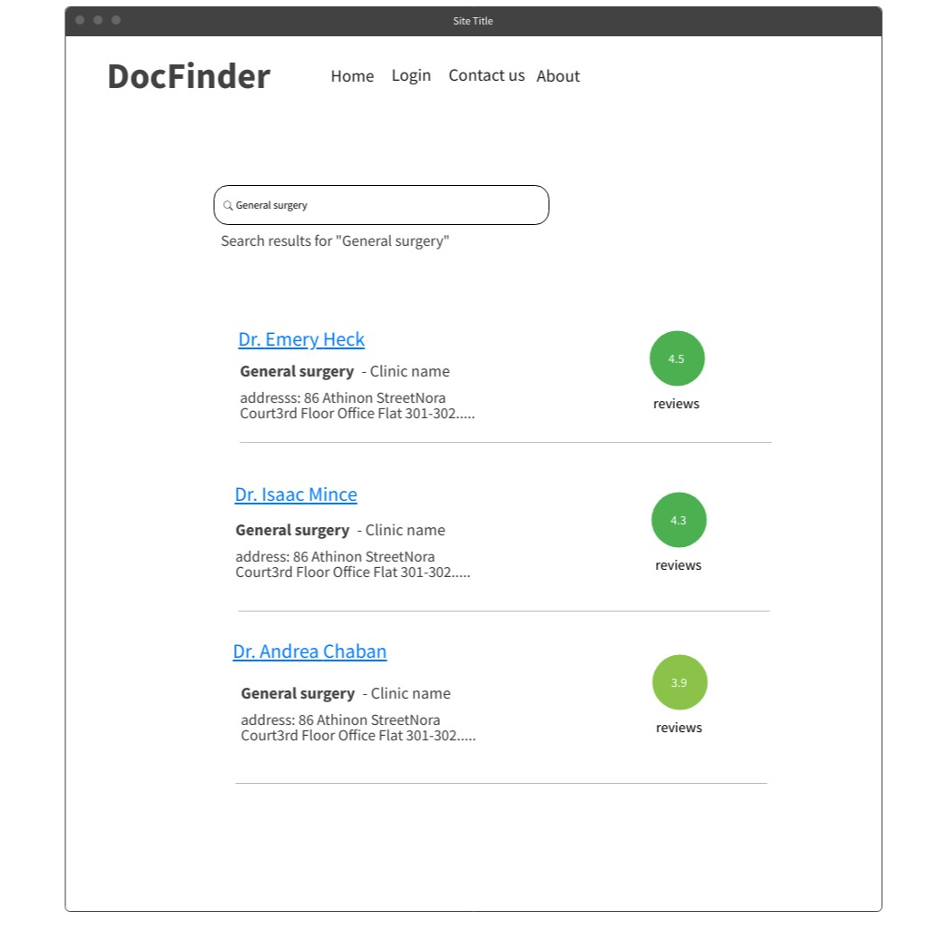
User interface
Search results

Slide 25
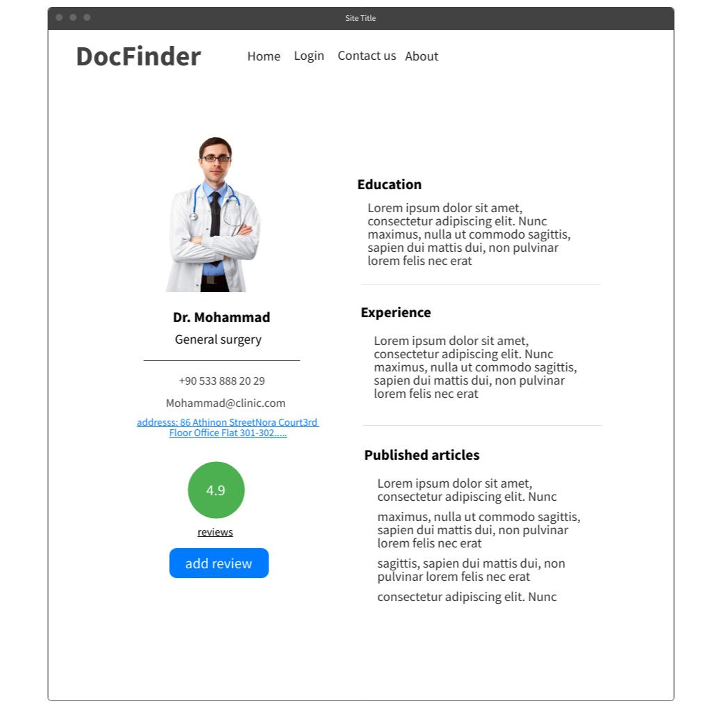
User interface
Doctor’s profile, info

Slide 26
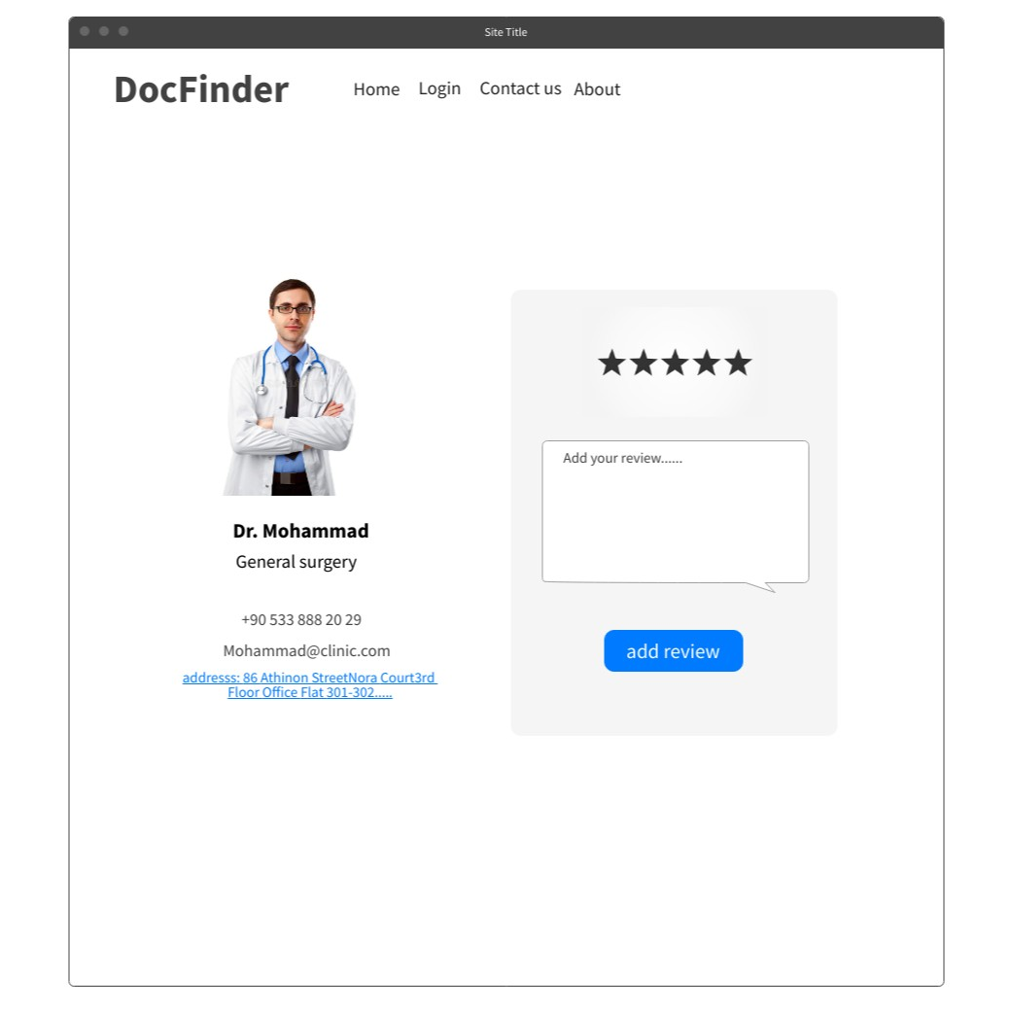
User interface
Rating a doctor

Slide 27
conclusion
As a team
Successfully finalized SRS and SDS.
SRS provides clear project requirements and objectives
SDS outlines detailed system design and architecture
Solid foundation for successful project execution
Clear direction and understanding of the system
Ready to proceed with development phase, Database Manager

Slide 28
Thank you ☺

